Slide 1


Employee Management System
Prepared By:
1) Name: Shah Ishan Rajubhai
Enr No: 23002171310152
3) Name: Prajapati Meet Rameshbhai
Enr No: 23002171310130
2) Name: Patel Neel Vimalbhai
Enr No: 23002171310116
4) Name: Trivedi Shlok Rikinbhai
Enr No: 23002171410066

Slide 2



PROJECT AGENDA
Introduction
Project Outflow
ER Diagram
Technologies Used
System Features
Future Scope

Slide 3
Introduction
Brief Overview: This is a Python-based system designed to streamline HR, employee, and manager tasks.
Key Features Mentioned: Role-based access, secure authentication, data management.

Slide 4
Project FLOWCHART
https://whimsical.com/employee-management-system-HvHZXqhDeEedBGfgo475SP

Slide 5
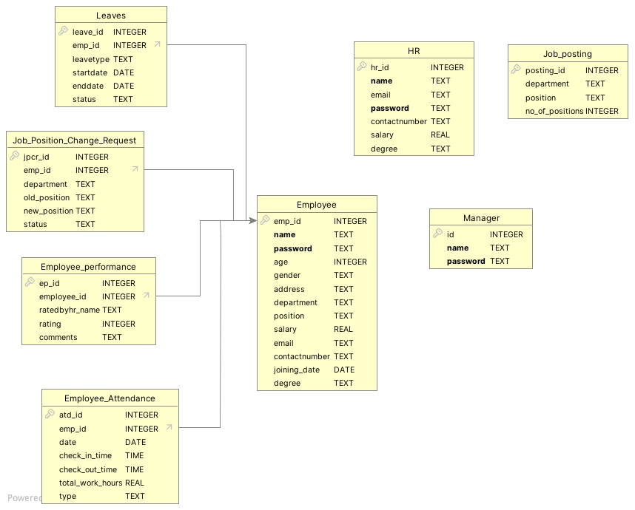
ER Diagram

Slide 6
Technologies used
Programming Language: Python
Database: SQLite
Libraries:
MATPLOTLIB (Graphs & Reports)
TABULATE (Table Formating)
Termcolor (Colored CLI)
OS Module (System operations)

Slide 7
SYSTEM FEATURES
Role-based Access Control:
HR Portal (Manages employees)
Employee Portal (Personal data & requests)
Manager Portal (Team management)
Other Features :
Secure authentication
Interactive command-line interface
SQLite-based data storage

Slide 8
Future Scope
Mobile Application integration
Email Notification System
Web Based Interface
Cloud Storage Integration
Advanced Analyatics and Ml integration

Slide 9
THANK YOU

